Slide 1



Motor Vehicle Thefts in Newzealand
Analysis of Theft Data and Prevention Strategies
View in Power BI
by : Elsayed Ibraheem
Last data refresh:
7/26/2024 4:48:08 PM UTC
Downloaded at:
7/26/2024 5:05:25 PM UTC

Slide 2
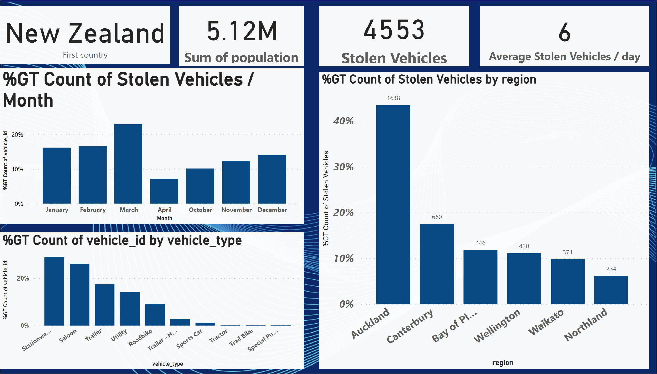
DashBoard
Notes:
card
No alt text provided
card
No alt text provided
card
No alt text provided
card
No alt text provided
%GT Count of Stolen Vehicles / Month
No alt text provided
columnChart
No alt text provided
columnChart
No alt text provided

